Slide 1

Close A.I. Parking Lot Finder

Slide 2
Table of contents
1
Problem vs. solution
2
About the product
3
Market & competition
4
Our business model

Slide 3
1
Problem vs. solution

Slide 4
Introduction
High cost
Limited parking space

Slide 5
Our company
Close A.I. Car park Finder aimed to help user find a reserved parking lot near the destination before driving. The idea is about sharing, user can rent other users’ parking space when it’s free.

Slide 6
Them
Us
High Cost
Congestion
Restrictions
Low Cost
Diversity of Choices
Potential for Personalized Services

Slide 7
Parking lot rating
Parking lot | Details | Review | Rating
Parking lot A | Mercury, Venus | “Mercury is a small planet”
Parking lot B | Earth, Mars | “Venus has a beautiful name”
Parking lot C | Jupiter, Saturn | “Earth is a planet that has life”
Parking lot D | Neptune, Pluto | “Mars is actually a cold place”

Slide 8
Our plans
$3
$30
Hourly Price
Daily Price

Slide 9
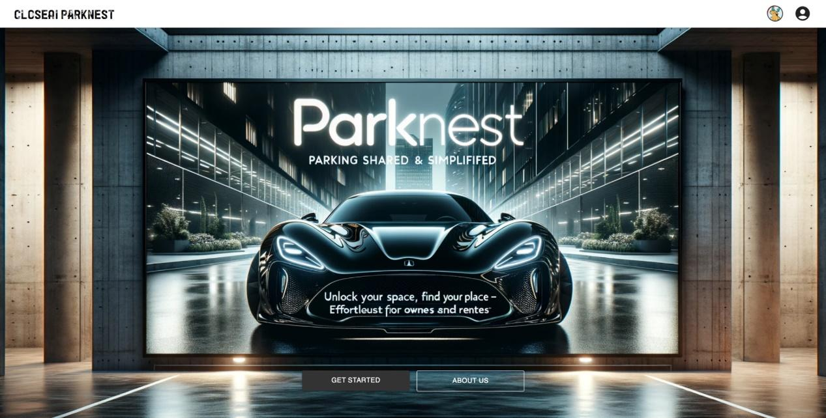
Product demo

